Slide 1


Digital Skill Fair 35.0 - Data Science
Simple Classification of Wine Dataset Using Decision Tree Method
Danica Alana Sjurjahady

Slide 2

Fresh graduate majoring in Agro-Industrial Technology from University of Darussalam Gontor, who have a strong interest in data analysis. Have a good understanding of basic concepts of statistics and machine learning. Skilled in using MySQL, Python, Google Looker Studio, Google Colab, and Microsoft Power BI. Ready to learn and grow in the role of Data Analyst.
ABOUT ME

Slide 3
INTRODUCTION
This dataset is from UC Irvine Machine Learning Repository. The data is the results of a chemical analysis of wines grown in the same region in Italy by three different cultivators. There are thirteen different measurements taken for different constituents found in the three types of wine.

Slide 4
CHARACTERISTICS
Number of Instances: 178
Number of Attributes: 13 numeric, predictive attributes and the class
Attribute Information: Alcohol, Malic acid, Ash, Alcalinity of ash, Magnesium, Total phenols, Flavanoids, Nonflavanoid phenols, Proanthocyanins, Color intensity, Hue, OD280/OD315 of diluted wines, Proline, and class (class_0, class_1, class_2)

Slide 5





TOOLS USED

Slide 6
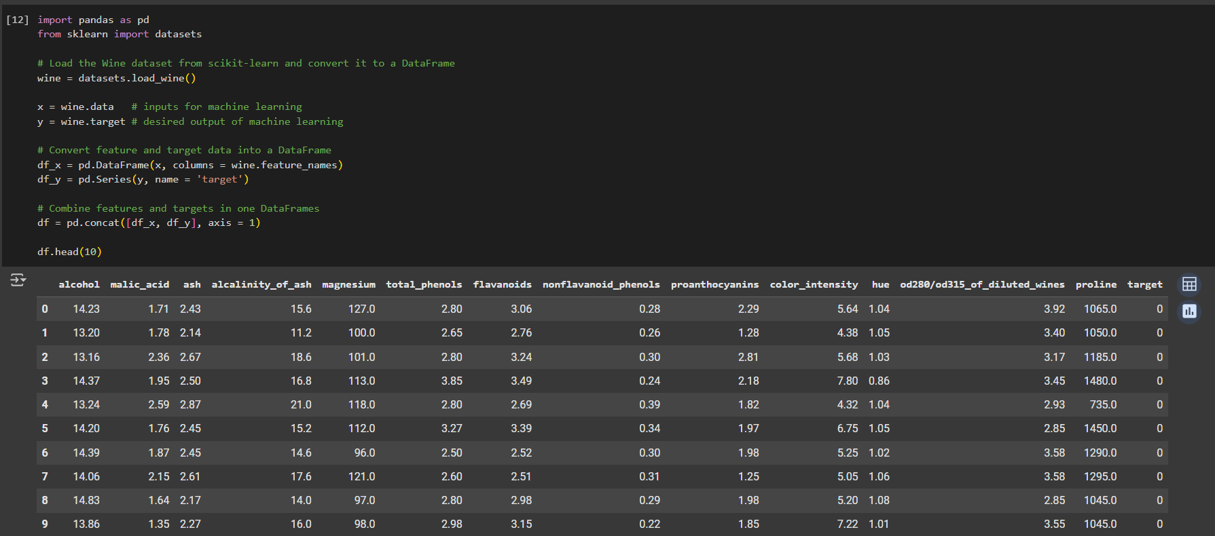
EXPLORATORY DATA ANALYSIS (EDA)

Slide 7
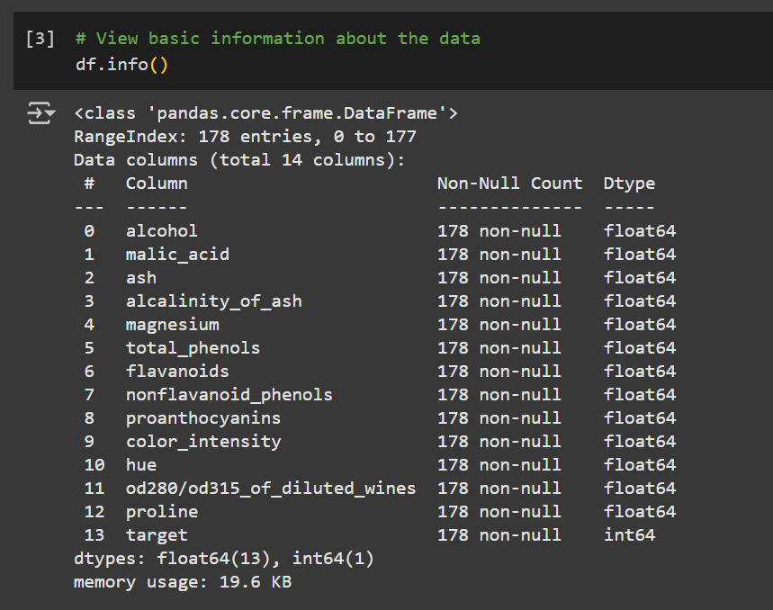
EXPLORATORY DATA ANALYSIS (EDA)

Slide 8
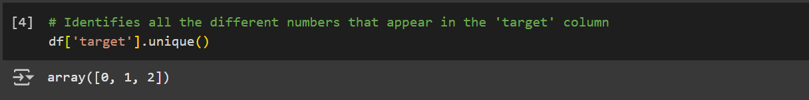
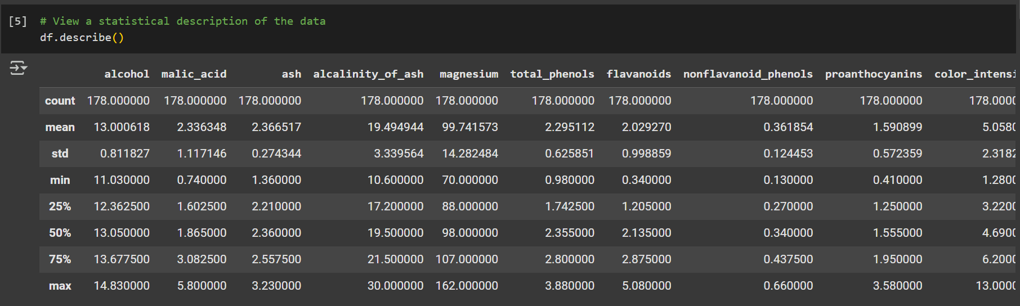
EXPLORATORY DATA ANALYSIS (EDA)

Slide 9
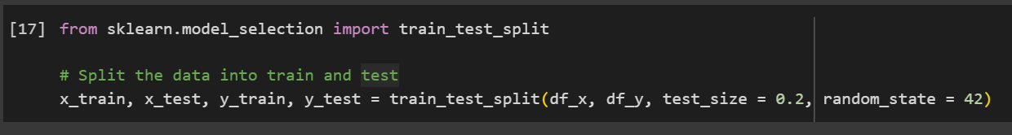
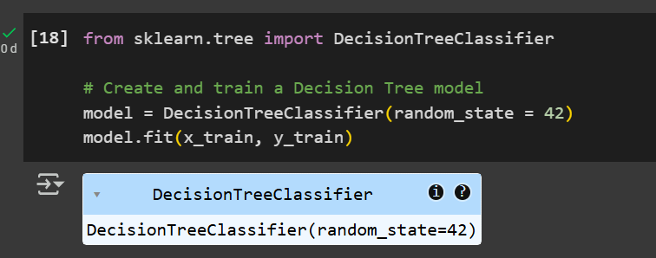
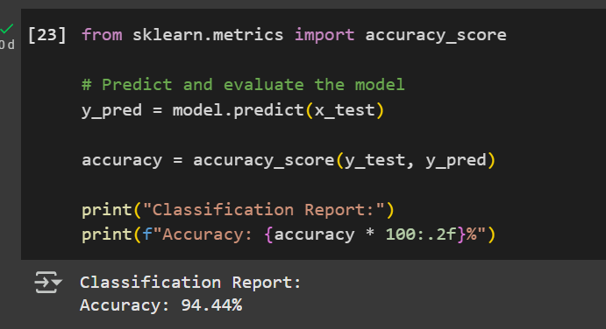
DATA MODELLING

Slide 10
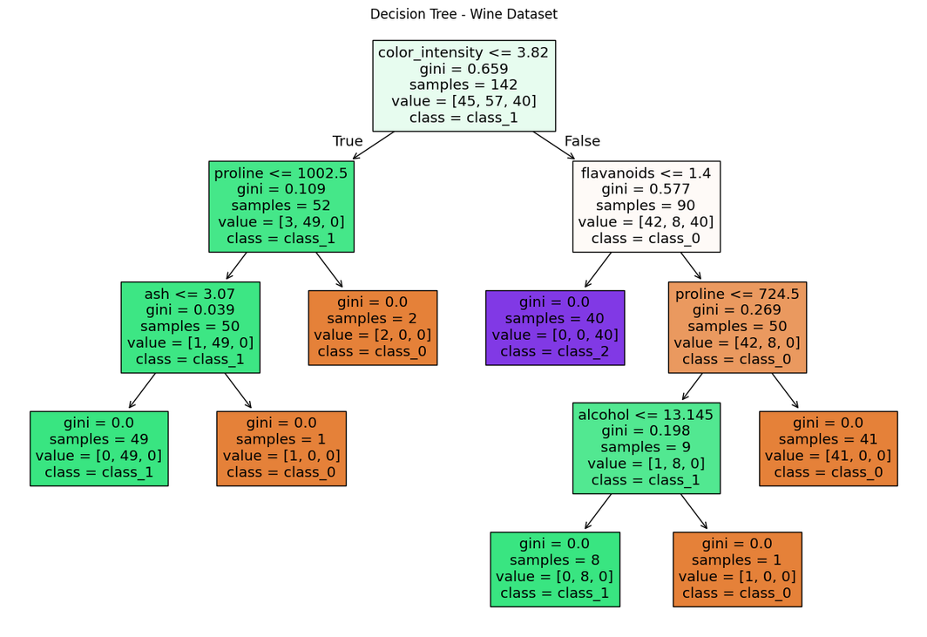
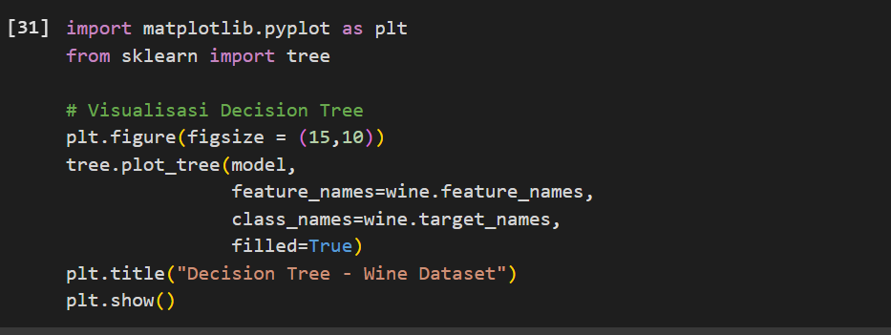
DATA VISUALIZATION

Slide 11



If you have any questions, suggestions or feedbacks, please do not hesitate to reach me through the contacts below:
rsgame99@gmail.com
github.com/DanicaAlana
linkedin.com/in/danica-alana-sjurjahady-85b124211/
THANK YOU

